Slide 1
A Framework for Fall Detection Using Audio and Video Features Project Team ID: MP23CE004 Under the Guidance of Dr. Durgaprasad Gangodkar Professor, Department of Computer Science & Engineering
Submitted By :
Aryamann Singh | 2017313
Medha Bisht | 2017341
Divyam Kholia | 2017324
Yogesh Thakur | 2017397

Slide 2
Introduction
According to WHO data, an estimated 684,000 fatal falls occur each year, for seniors aged 79 and above, falls are the primary reason for injury-related deaths, making it the second leading cause of unintentional death, after road injuries. [1]
The current methods commonly used to detect falls are portable sensors which need to be worn or embedded on various parts of the human body, for them to be able to detect falling events experienced by the person. If the wearer of these portable devices falls, a signal is sent to a response center for analysis and subsequent resolution. [9]
The main issue with a fall detection system is to differentiate any fall from daily life activities like crouching, sitting down, etc. So, to achieve that the event of fall can be divided into three parts: the pre-fall phase represents the daily life activities. Secondly, the critical phase which lasts for a very brief moment represents the movement of the body towards the ground or the shock of the body’s impact with the ground. Thirdly, the post-fall phase represents the motionlessness of the person after falling on the ground. [7]

Slide 3
Problem Statement
Falls can lead to severe injuries, diminished quality of life, and, in unfortunate cases, even fatal consequences. As the elderly population grows worldwide, there is a demand for better surveillance systems, specifically fall detection systems to tackle this issue. A fall detection system based on vision, that can automatically monitor and detect falls, recognize distress calls from the injured, and send out help messages to local emergency numbers for timely medical care. When the system identifies a potential fall and determines distress through audio cues, it automatically triggers a call for help.

Slide 4
Literature Review
Fall detection systems can be divided into 2 types: environmentally smart systems and wearable devices. This literature survey [10] discusses how Early fall detection approaches from 2013 to 2017 focused on wearable sensors.
Wearable Sensors utilize sensors [15,16] placed on a person’s body, such as accelerometers or gyroscopes, commonly found in fitness wearables or mobile phones. For the studies using wearable devices, it illustrate that six out of 20 studies that we reviewed can detect falls and send alarms. Wearable Sensors utilize sensors placed on a person’s body, such as accelerometers or gyroscopes, commonly found in fitness wearables or mobile phones [1].
However, user acceptance and comfort were major concerns [6,7]. On the other hand environmental systems employ external sensors like cameras, floor sensors, infrared sensors, microphones, or pressure sensors.
Various fall-detection solutions [5,9] have been previously proposed to create a reliable surveillance system for elderly people with high requirements on accuracy, sensitivity, and specificity The first approach being accelerometers, second using gyroscopes, third and fourth being about visual detection.

Slide 5
Problems with Existing Work
Current fall detection systems have limitations [11,18], the problems that were faced in using an accelerometer for a fall detection system were its sensitivity and specificity. Also, it is hard to adjust an accelerometer to maintain its accuracy.
While using a gyroscope for a fall detection system the main issue was its energy consumption and cost. The gyroscopes are costly but they are not suitable for fall detection as they are sensitive to even small movements leading to false detections and missed detections.[20]
Real-time is a key feature for fall detection systems, especially for public use. Considering that certain falls can be fatal or harmful to health, the deployed fall detection systems must have a high level of efficiency, preferably operating in (near) real-time. [13]
The percentage of studies applying real-time detection by static visual sensors is lower than that of wearable devices. For the studies using wearable devices, It illustrate that six out of 20 studies that we reviewed can detect falls and send alarms.[13]

Slide 6
Objectives
Detect falls in complex situations: To accurately detect falls based on the video and live time camera feed, even in challenging environments.
Distress Call: To accurately detect falls based on the distress call made by the person during or after the fall for help, even in a noisy environment.
Alerting Family: To alert the family members of the person whenever a fall is noticed so that they can take any important steps regarding that situation.
Removal of False Alarm: To minimize the number of false alarms, which can be caused by other activities, such as sitting down or lying down.

Slide 7
Methodology
We created a fall detection system using MediaPipe with both audio and video features involves multiple steps including data collection, preprocessing, then algorithm is applied on the input to whether the subject is fallen or not in the particular video input or not and at last the output is displayed in the feed and an alert is sent to concerned parties as well.
We collected a diverse set of videos that include both fall and non-fall activities. Ensuring the videos have various backgrounds, lighting conditions, and angles.
We also corresponded to the fall events, capturing sounds that might be indicative of a fall like a cry for help.
In the preprocessing part the code first reduces the resolution of the video given as input and later first converts the video from BGR to RGB for the CNN model for human detection and later coverts it back to BGR to check for fall in the respective frame.

Slide 8
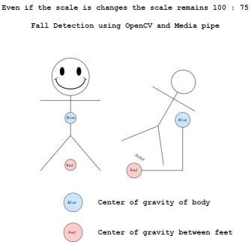
Algorithm Used
The algorithm works in such a way that based on the coordinates detected by the media pipe framework it calculates the most probable center of mass for the human and if that condition passes then it checks for different angles of the human body parts of the person in frame and if that case passes it detects for the body of the human in frame CNN framework that helps in differentiating between the length and breadth of the human body and if the breadth of the body is more than that of the length then, in the end, the framework considers it as a fall and sends a message to concerned people.

Slide 9
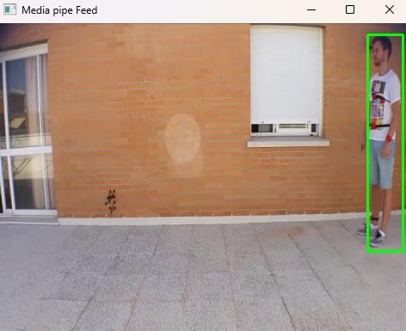
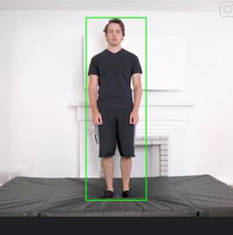
Results (Standing)
Portray the fulfillment of the conditions of standing/no fall.
The center of mass of the subject is on the base of the human body.
The width of the body is also less than the length.

Slide 10
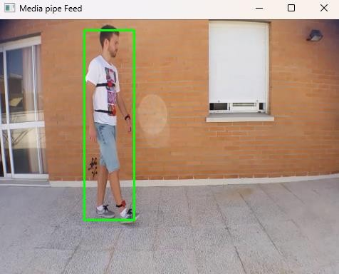
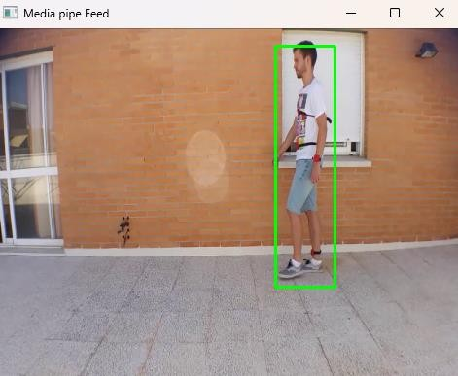
Results (Walking)
Portray the fulfillment of the conditions of walking/no fall.
The center of mass of the subject is on the base of the human body.
The width of the body is also less than the length.
Also, the person is walking so no false call is made in case of daily activity.

Slide 11
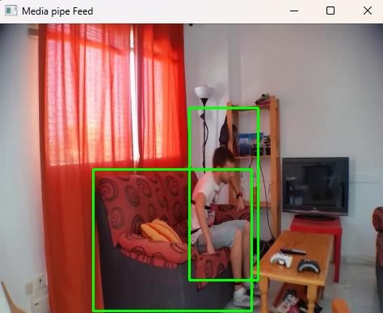
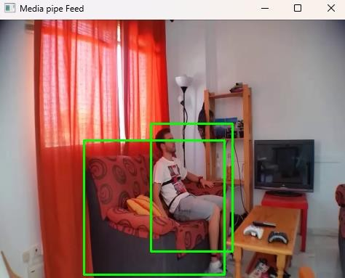
Results (Sitting)
Portray the fulfillment of the conditions of sitting/no fall.
The center of mass of the subject is on the base of the human body.
The width of the body is also less than the length.
Also, the person is sitting so no false call is made for such daily activity.

Slide 12
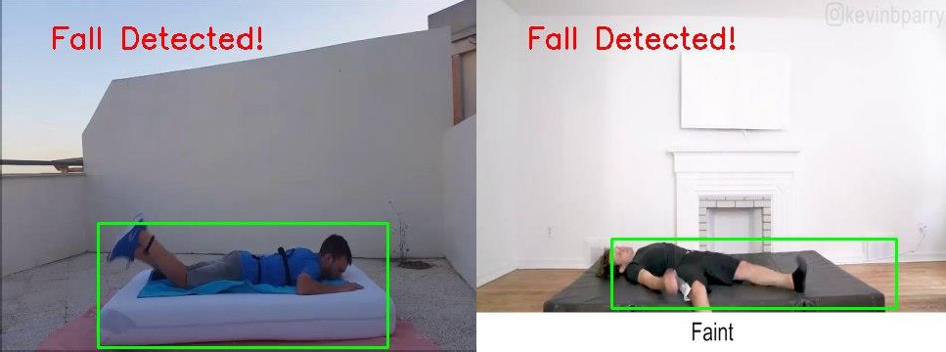
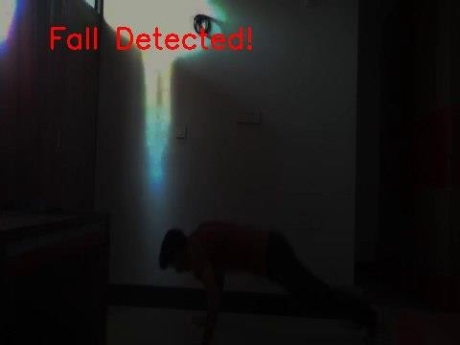
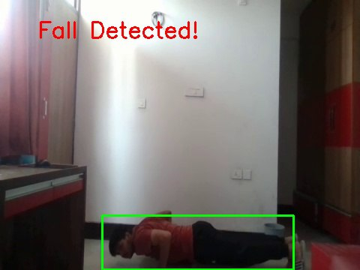
Results (Falls)
Portray the fulfillment of the condition of fall.
The center of mass of the subject is out of the base of the human body.
The width of the body is also more than the length.
Also, as the person falls the message “Fall Detected!” is displayed on the screen.

Slide 13
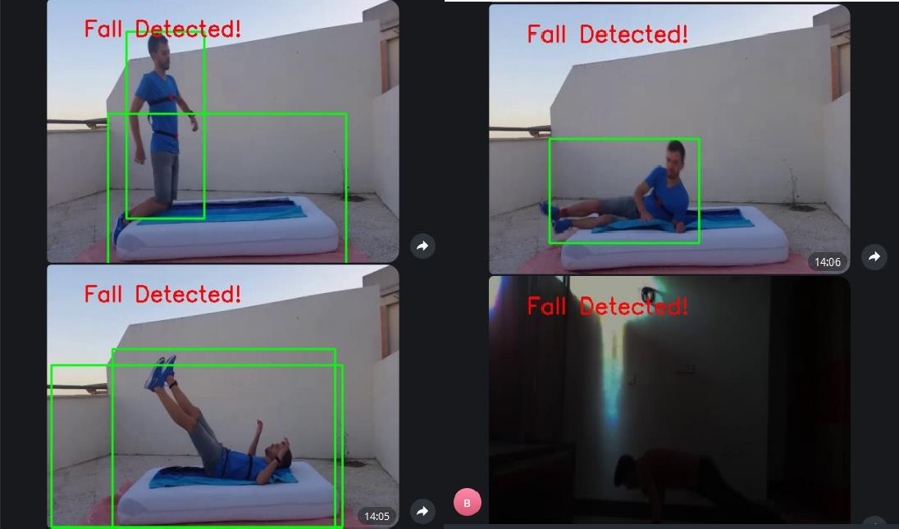


Results (Messages)
Displays how a message is generated for the keyword “help”.
Displays the message sent using the telegram bot as an alert.
As soon as the word help is detected in the speech of the subject either in or out of the frame of the camera a message is generated to send an alert to concerned parties.
In case of audio based detected fall a text message is sent using the bot.

Slide 14
Conclusion
The development of the fall detection system that integrates audio and video features represents a significant advancement in ensuring the safety and well-being of individuals, particularly the elderly and those with mobility issues. Through comprehensive and rigorous testing methods, the system has demonstrated its potential to accurately identify falls, thereby enabling timely intervention and reducing the risk of severe injury.
The system's ability to analyze both audio and video data provides a robust mechanism for detecting falls. Video analysis captures body movements and postures, while audio analysis can detect sudden sounds associated with falls. The integration of these modalities enhances the system's accuracy, addressing the limitations of relying on a single type of sensor data.
Challenges Addressed:
False Positives/Negatives
Latency

Slide 15
Future Work
Differentiating between a fallen and an asleep person is a valuable enhancement for the fall detection system, as it reduces false alarms and ensures appropriate responses. Develop audio analysis algorithms to detect sounds associated with falls, such as thuds or sudden impacts, and compare them to the ambient noise typically present when a person is asleep.

Slide 16
Detail of Publication
The details of our research publication are as follows:
A. Singh, M. Bisht, D. Kholia, Y. Thakur and D.R Gangodkar, " A Framework for Fall Detection Using Audio and Video Features" (Being Prepared).

Slide 17
References
[1]. V. Viet and D.-J. Choi, "Fall Detection with Smartphone Sensor," in Proc. 3rd ICONI Conf., Chonnam National University, 2011, pp. 2011.
[2]. Noor, T.H. Human Action Recognition-Based IoT Services for Emergency Response Management. Mach. Learn. Knowl. Extr. vol. 1, no. 5, 2023, pp. 330-345.
[3]. Miao Yu, Liyun Gong, and Stefanos Kollias. 2017. Computer vision-based fall detection by a convolutional neural network. In Proceedings of the 19th ACM International Conference on Multimodal Interaction (ICMI '17). Association for Computing Machinery, New York, NY, USA, 2017, pp. 416–420.
[4]. Vishwakarma, V., Mandal, C., Sural, S. (2007). Automatic Detection of Human Fall in Video. In: Ghosh, A., De, R.K., Pal, S.K. (eds) Pattern Recognition and Machine Intelligence. PReMI 2007. Lecture Notes in Computer Science, vol 4815. Springer, Berlin, Heidelberg, 2007, pp. 616-623.
[5]. K. Gunale and P. Mukherji, "Indoor human fall detection system based on automatic vision using computer vision," Journal of Engineering Science and Technology, vol. 13, no. 8, pp. 2587-2605, Aug. 2018.
[6]. S. Khawandi, B. Daya, and P. Chauvet, "Implementation of a monitoring system for fall detection in elderly healthcare," Procedia Computer Science Conf., vol. 3, pp. 216-220, 2011.
[7]. L. Hazelhoff, J. Han, and P.H.N. de With, "Video-Based Fall Detection in the Home Using Principal Component Analysis," in Advanced Concepts for Intelligent Vision Systems, J. BlancTalon et al. (eds.), Lecture Notes in Computer Science, vol. 5259, Springer, Berlin, Heidelberg, 2008, pp. 27-36.
[8]. S. Usmani, A. Saboor, M. Haris, M.A. Khan, and H. Park, "Latest Research Trends in Fall Detection and Prevention Using Machine Learning: A Systematic Review," Sensors, vol. 21, 2021, pp. 5134.
[9]. An eight-camera fall detection system using human fall pattern recognition via machine learning by a low-cost Android box. [Online]. Available: www.nature.com/articles.
[10]. Igual, R., Medrano, C. & Plaza, I. Challenges, issues and trends in fall detection systems. BioMed Eng OnLine, vol. 12, article 66, 2013.

Slide 18
[11]. Muhammad Mubashir, Ling Shao, Luke Seed, “A survey on fall detection: Principles and approaches”, Neurocomputing, vol. 100, 2013, pp. 144-152. [12]. Xu, T.; Zhou, Y.; Zhu, J. "New Advances and Challenges of Fall Detection Systems: A Survey" Applied Sciences 8, no. 3: 418, 2018.
[13]. J. T. Perry, S. Kellog, S. M. Vaidya, J. -H. Youn, H. Ali and H. Sharif, "Survey and evaluation of real-time fall detection approaches," 2009 6th International Symposium on High Capacity Optical Networks and Enabling Technologies (HONET) Conf., Alexandria, Egypt, 2009, pp. 158-164
[14]. J. Chen, K. Kwong, D. Chang, J. Luk and R. Bajcsy, "Wearable Sensors for Reliable Fall Detection," 2005 IEEE Engineering in Medicine and Biology 27th Annual Conf., Shanghai, China, 2005, pp. 3551-3554.
[15]. M.N. Nyan, Francis E.H. Tay, E. Murugasu, “A wearable system for pre-impact fall detection”, Journal of Biomechanics, vol. 41(16), 2008, pp. 3475-3481.
[16]. Jiangpeng Dai, Xiaole Bai, Zhimin Yang, Zhaohui Shen and Dong Xuan, "PerFallD: A pervasive fall detection system using mobile phones," 2010 8th IEEE Int. Conf. on PERCOM Workshops, Mannheim, Germany, 2010, pp. 292-297.
[17]. Shehroz S. Khan, Jesse Hoey, “Review of fall detection techniques: A data availability perspective”, Medical Engineering & Physics, vol. 39, 2017, pp. 12-22.
[18]. K. Chaccour, R. Darazi, A. H. El Hassani and E. Andrès, "From Fall Detection to Fall Prevention: A Generic Classification of Fall-Related Systems," in IEEE Sensors Journal, vol. 17, no. 3, pp. 812-822, 1 Feb.1, 2017.
[19]. O. Ojetola, E. I. Gaura and J. Brusey, "Fall Detection with Wearable Sensors--Safe (Smart Fall Detection)," 2011 7th Int.l Conf. on Intelligent Environments, Nottingham, UK, 2011, pp. 318-321.
[20]. K. Singh, A. Rajput, S. Sachin, "Human Fall Detection Using Machine Learning Methods: A Survey", International Journal of Mathematical, Engineering and Management Sciences, Graphic Era University, Dehradun, Uttarakhand, IN, Vol. 5, No. 1, 161-180, 2020

Slide 19
Thank You 🫡

